Slide 1

Git/Github introduction/tutorial Will Buziak 1/11/23

Slide 2
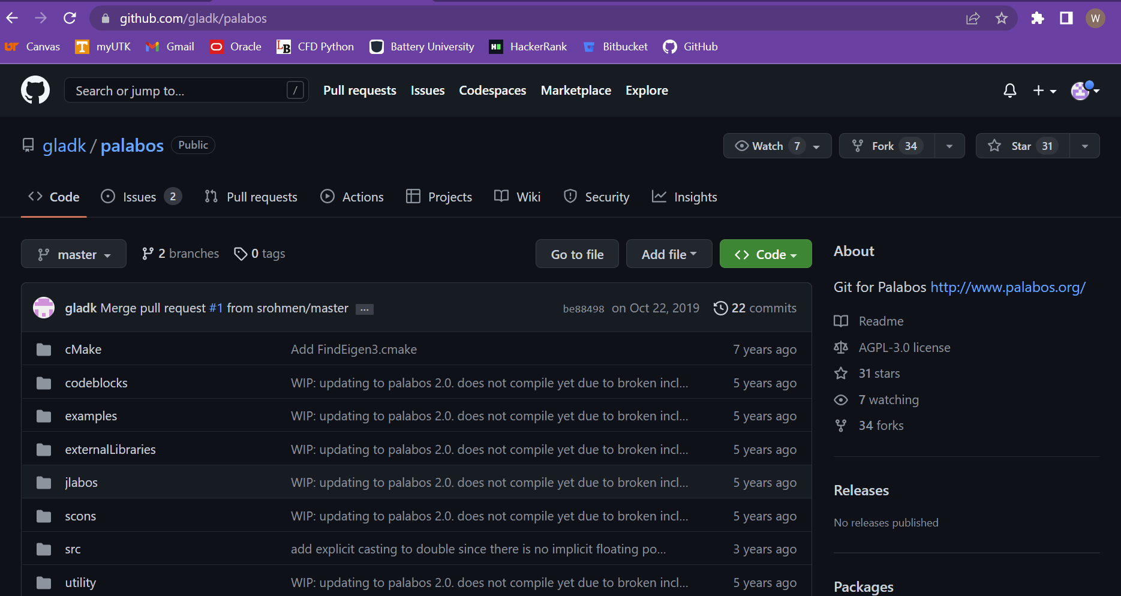
What is Git/Github?
Git is a “form of distributed version control”
Essentially a way to track, collaborate and share “repositories” of programs and files
Operates through the command line in your terminal
Github is a website that hosts Git repositories
Open-source cloud storage for “repositories”
Communicates with your computer(s) through Git
Github repositories have a user-friendly interface that allows easy navigation and different developer tabs

Slide 3
Why Git?
Git was designed for version control. Meaning that there is a well-established record of changes made to each file.
Git allows “cloning” entire repositories of files that can run on a local machine quickly and seamlessly.
Github repos can be specified as public or private and can invite collaborators and adjust permissions
Proper use of Git creates multiple backups and can be worked on offline
Git/Github is opensource
Git can manage many files at once

Slide 4
Why not other file managers?
Other file managers like google drive allow for effective file streaming and collaboration
Great for collaboration on files that do not need to be compiled
Keeps a consistent streaming record of changes you make and stores in the cloud
Git/Github (and other services like it) tracks previous generations of the same file(s)
Seamless to revert to a previous version
Designed to assist developers collaborate and manage software projects
Supports “forking” and “branching” which are two different ways one can develop a project in isolation from the Github repo
Github repositories can function as their own instruction manuals through “README.md” markdown files

Slide 5
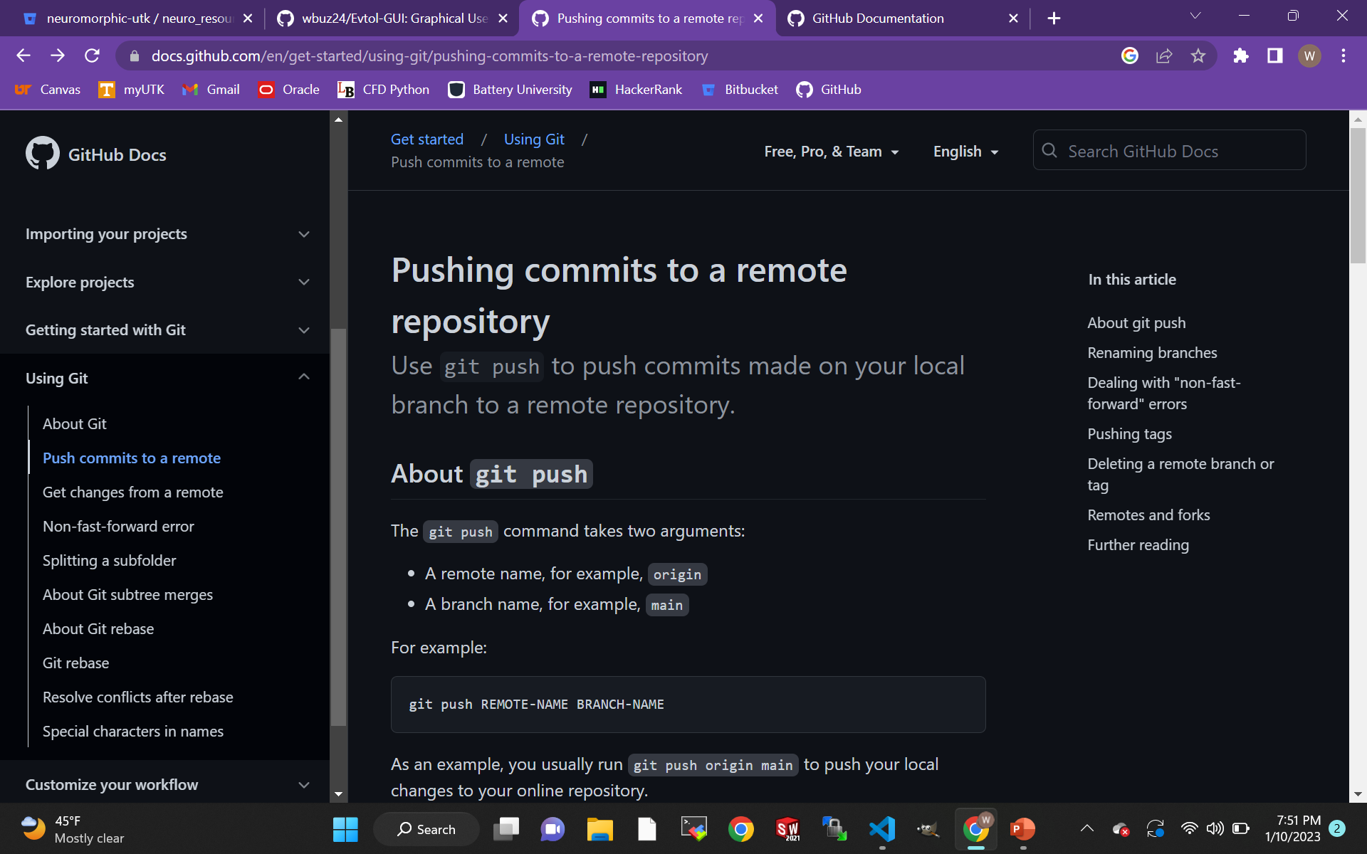
Github Docs is your friend

Slide 6
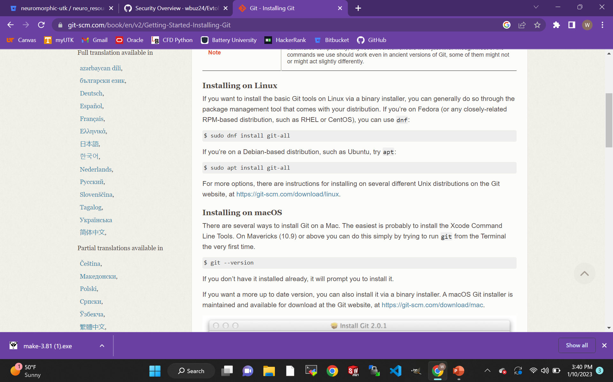
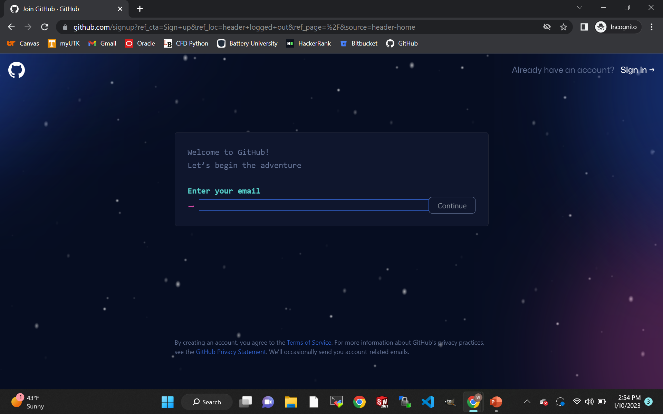
Getting started with Git
Create an account on Github.com using your school email
Download Git depending on your OS

Slide 7
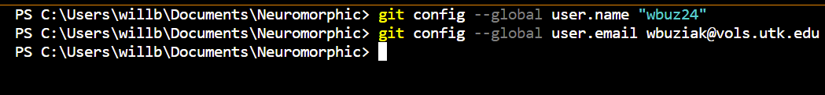
Connect your local Git account with Github
Open your terminal and run the following commands: (“git - -version” will check the version installed)
Configure your username
Configure your school email (use github generated noreply email if preferences are set to private)
“--global” flag configures for every repository on your computer
Now, your local machine will identify you when you push commits to the remote repository

Slide 8
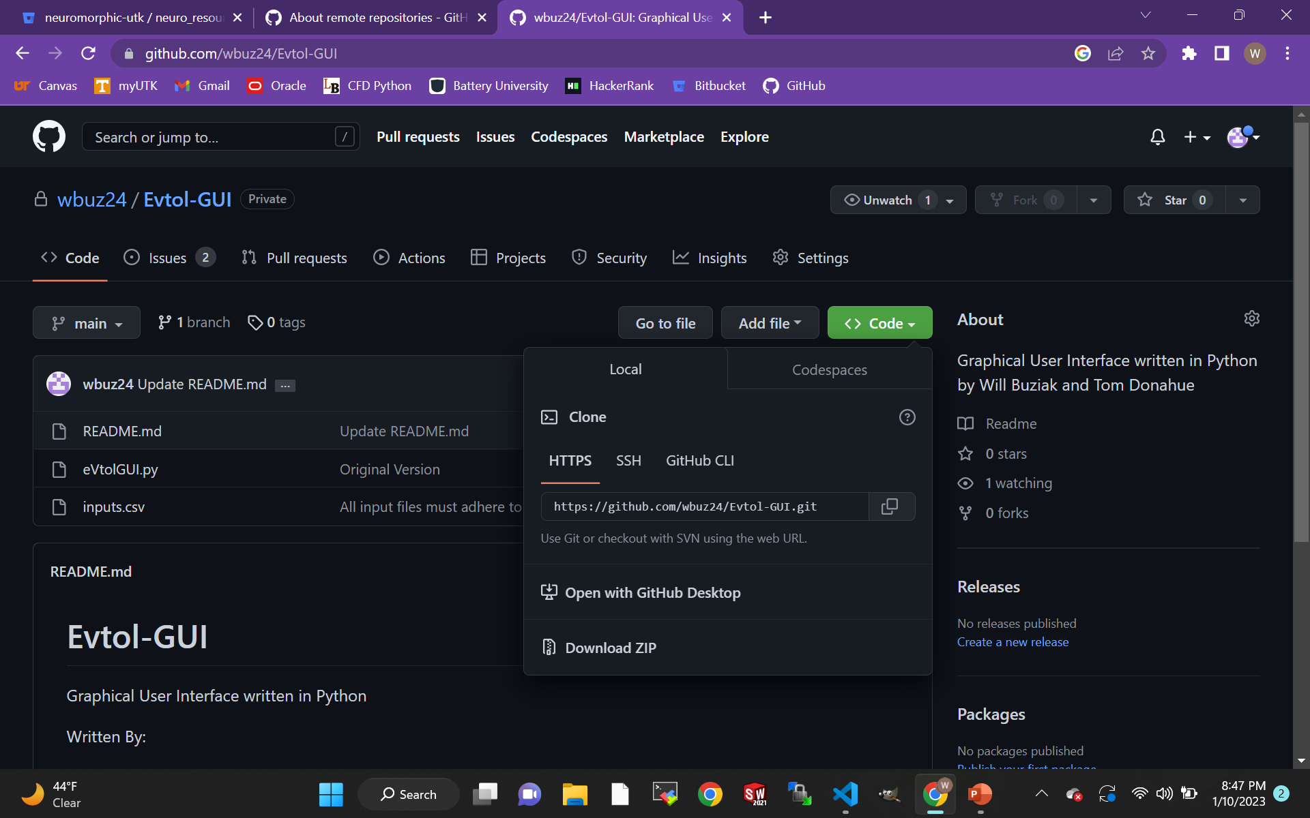
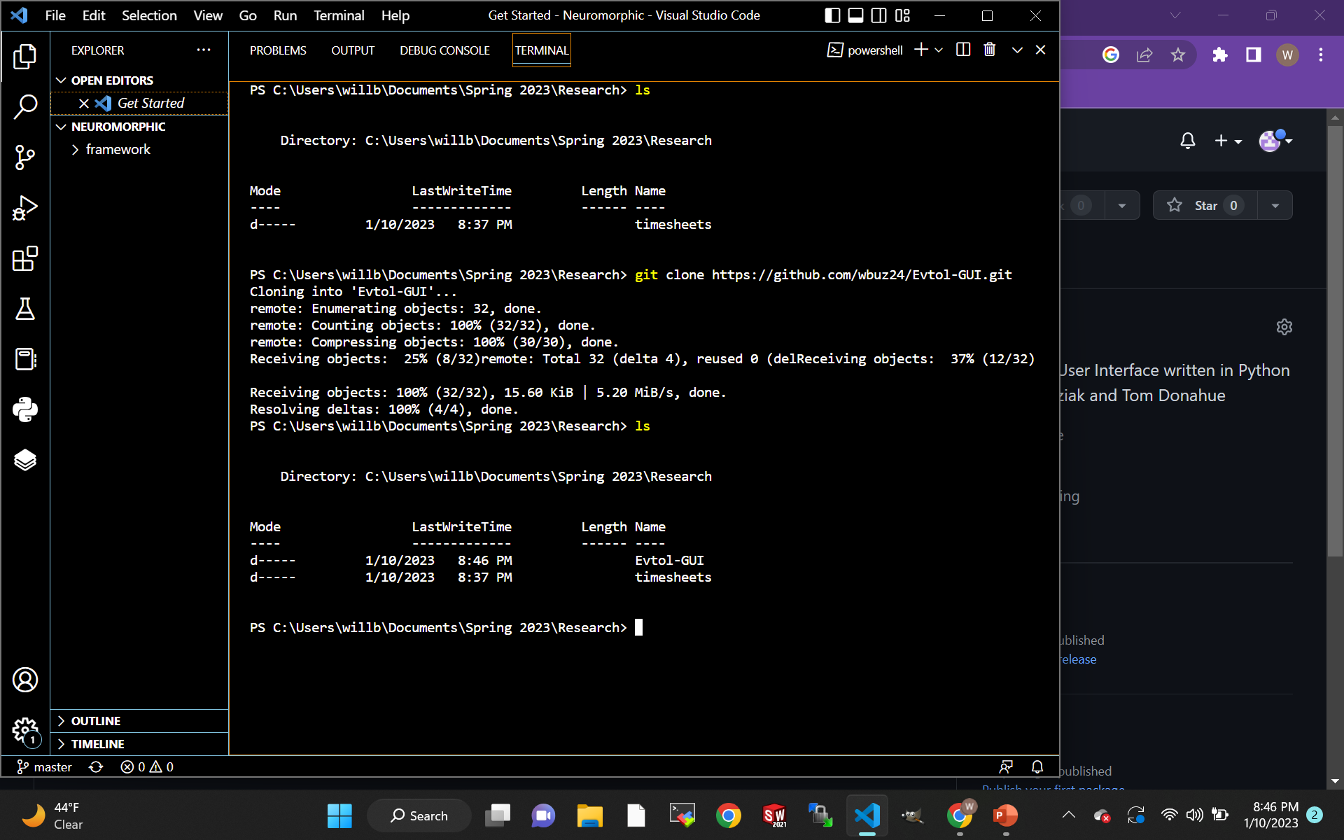
Methods of cloning from a remote with “git clone”
The most complicated method is by connecting to Github with SSH keys.
“git clone <SSH URL>”
SSH keys allow you to bypass your password when you clone, pull or push
The easiest way to clone a remote is by using the Github generated HTTPS URLs
“git clone <URL>”

Slide 9
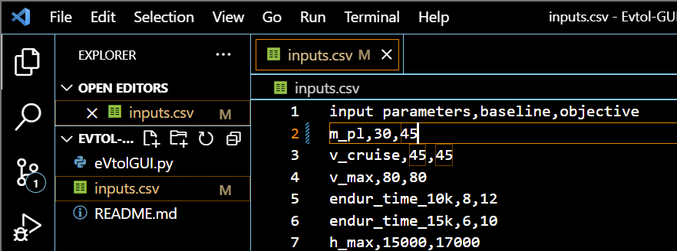
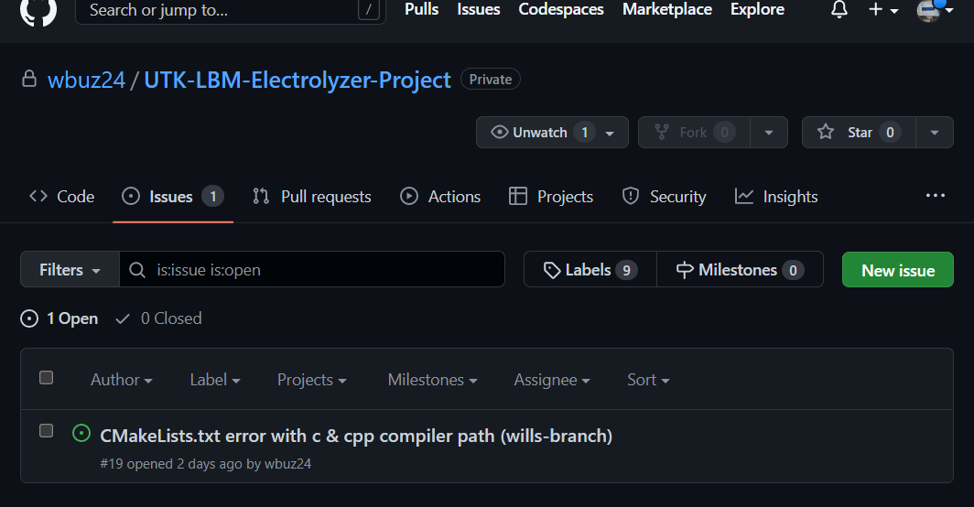
Git breaks “uploading” into sections
Now, you have a local copy of the repository you just cloned, and Git will monitor your changes
Git is broken up into sections and files can be moved with various commands
The basic workflow of Git:
Clone a repository
Modify a file
Stage a file
Commit the file to be stored in the repo
Push the branch to Github
Initiate a pull request to request a merge
Review and merge the branches
Untracked files are not stored in Git

Slide 10
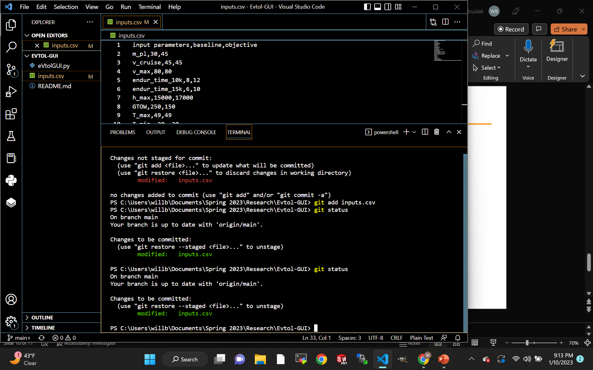
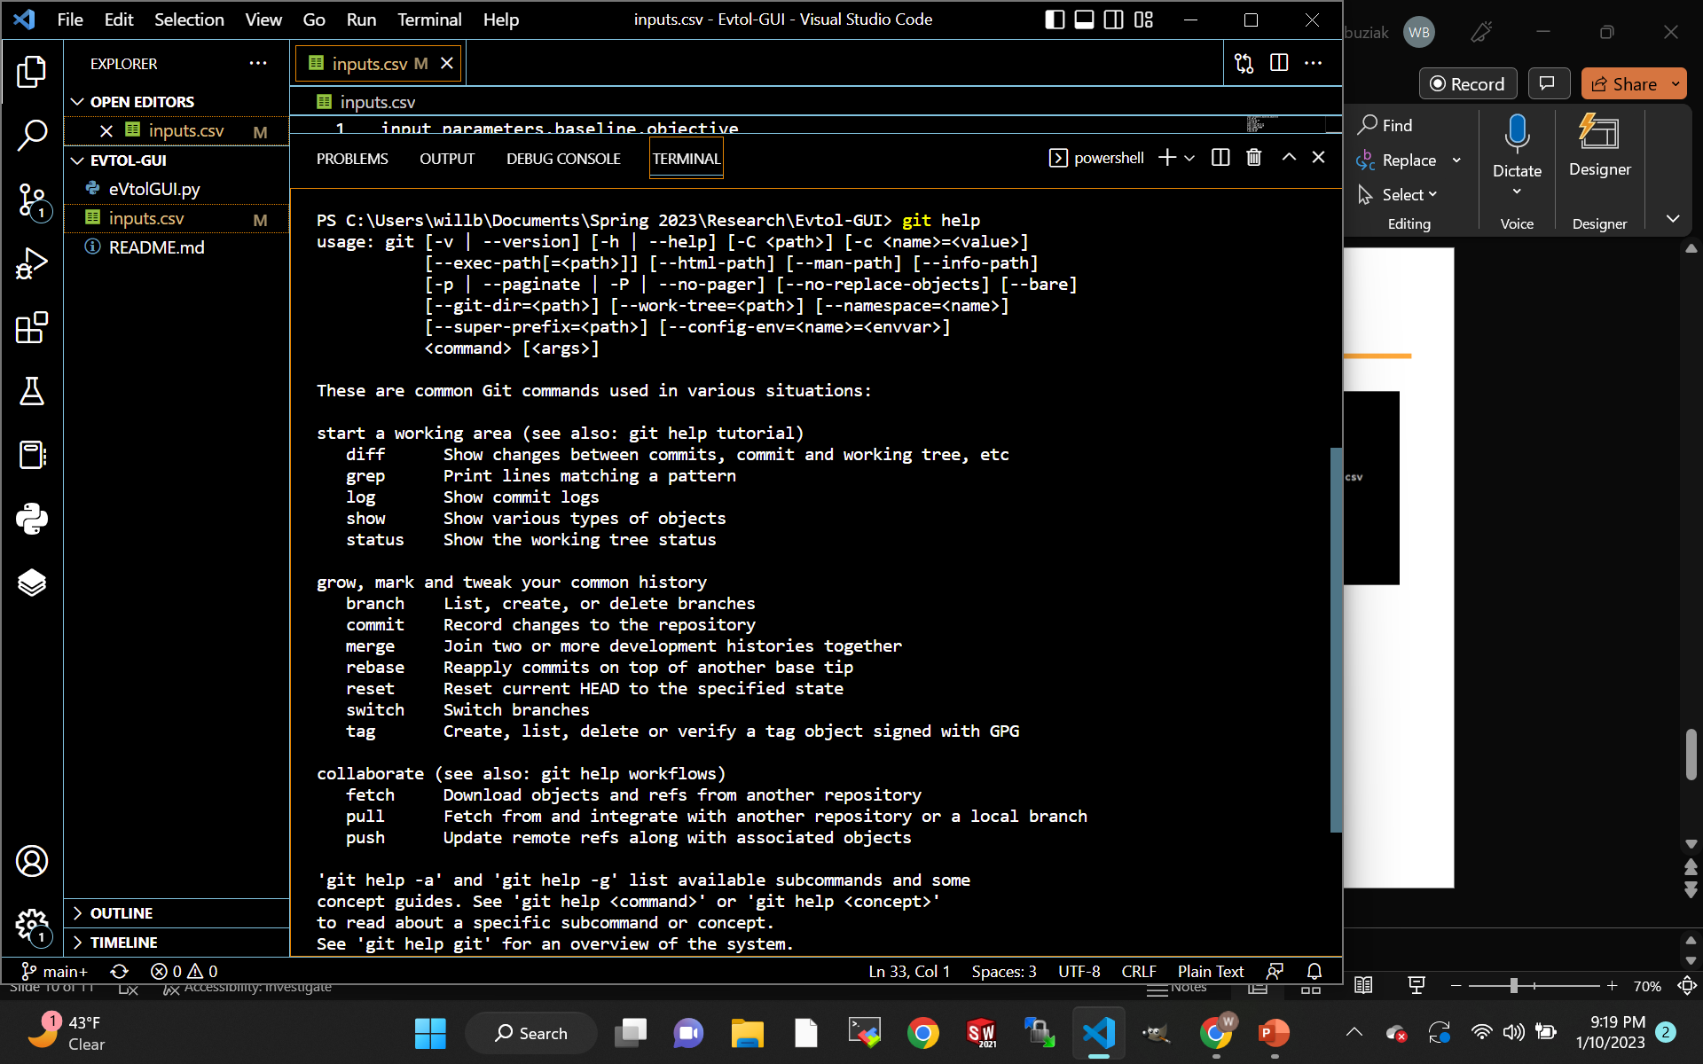
“git status” will report the status of the working directory
The “staging” area is for files that will be pushed in the next commit
“git add <file>” moves a file into the staging area
“git restore --staged <file>” removes a file from the staging area
‘git commit -m “<message>”’ commits (timestamps) the stage area for pushing
“git push <remote> <branch>” pushes (uploads) the branch to Github
“git help” will return an overview of commonly used commands

Slide 11
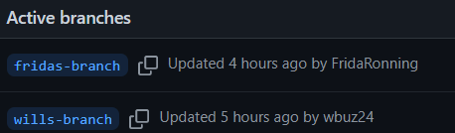
Create a new branch when pushing to Github
When committing to a remote, it is important to ensure that you create a new branch
Switch to a new branch with “git switch -c <branch-name>”
“Branches” allow you to experiment with a commit in isolation from the main branch
Branches can be merged to the main branch with a pull request
“Pull requests” are notifications to collaborators that you have made changes to a branch and seek to merge it to the main branch

Slide 12
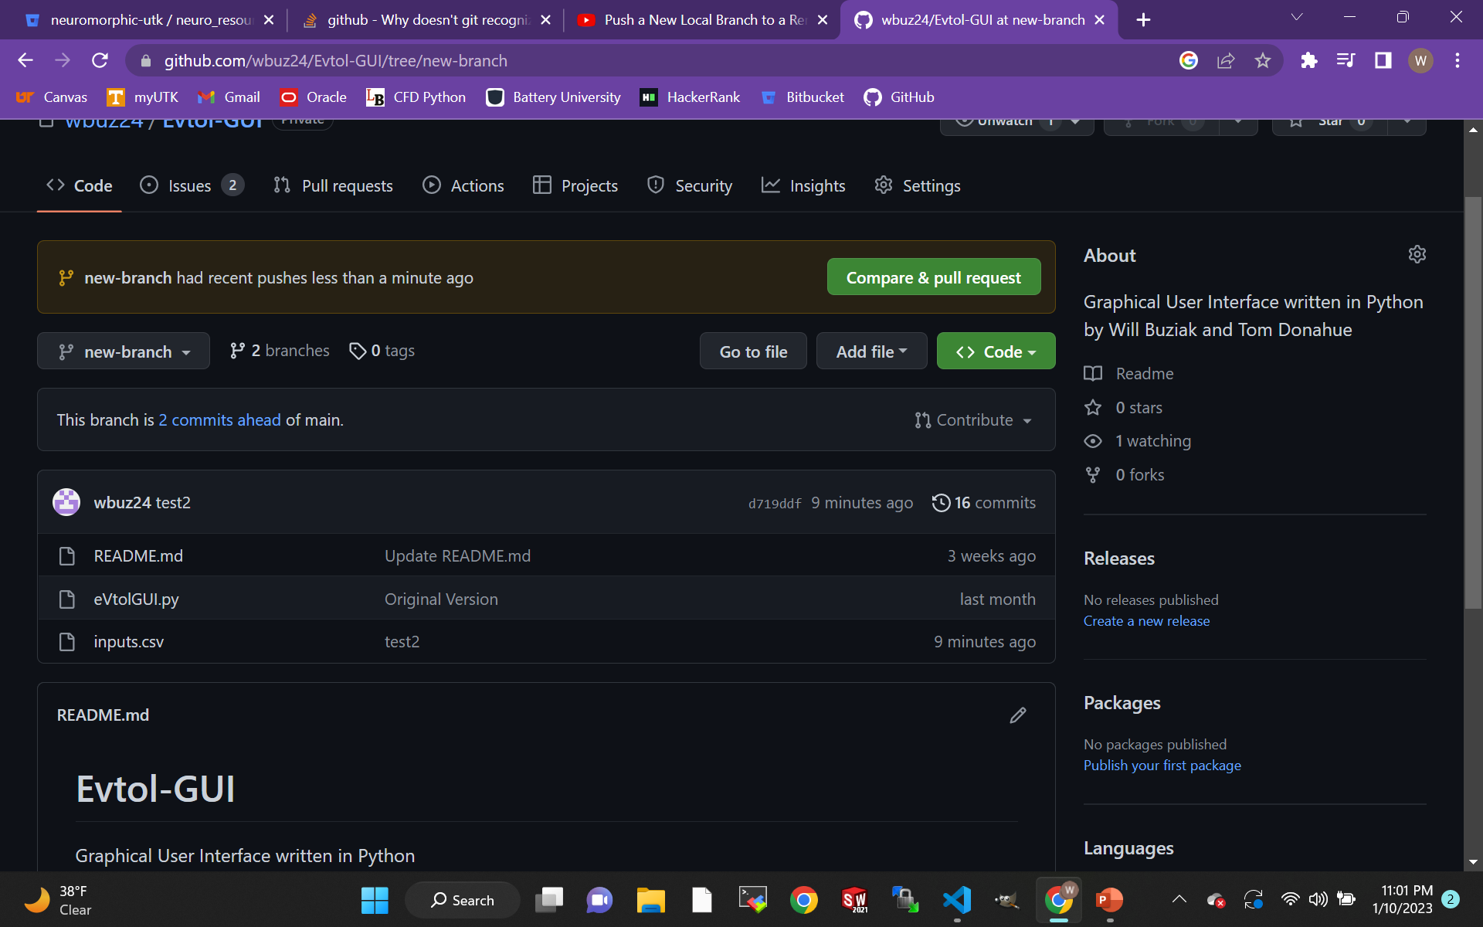
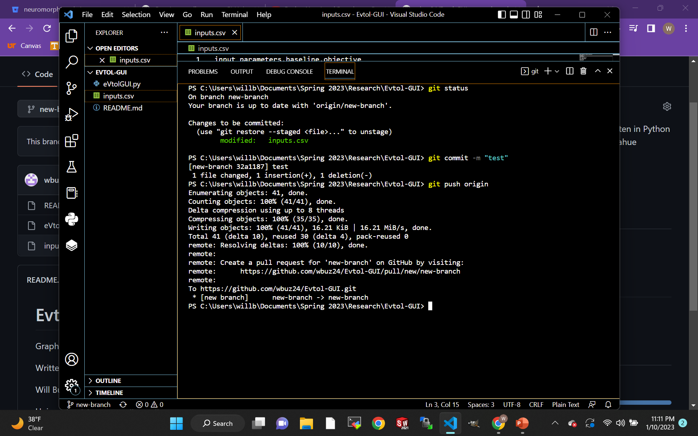
“git switch -c <branch>” creates a new branch
After changes to a file are made:
“git add <file>” adds the file to the stage area
“git commit –m “<message>”” creates a new commit of what is in the stage area with a description
“git push <remote> <branch>” will push your branch to Github and can be seen online
If given issues on pushing a new branch, try “git push --set-upstream <remote> <branch>”

Slide 13
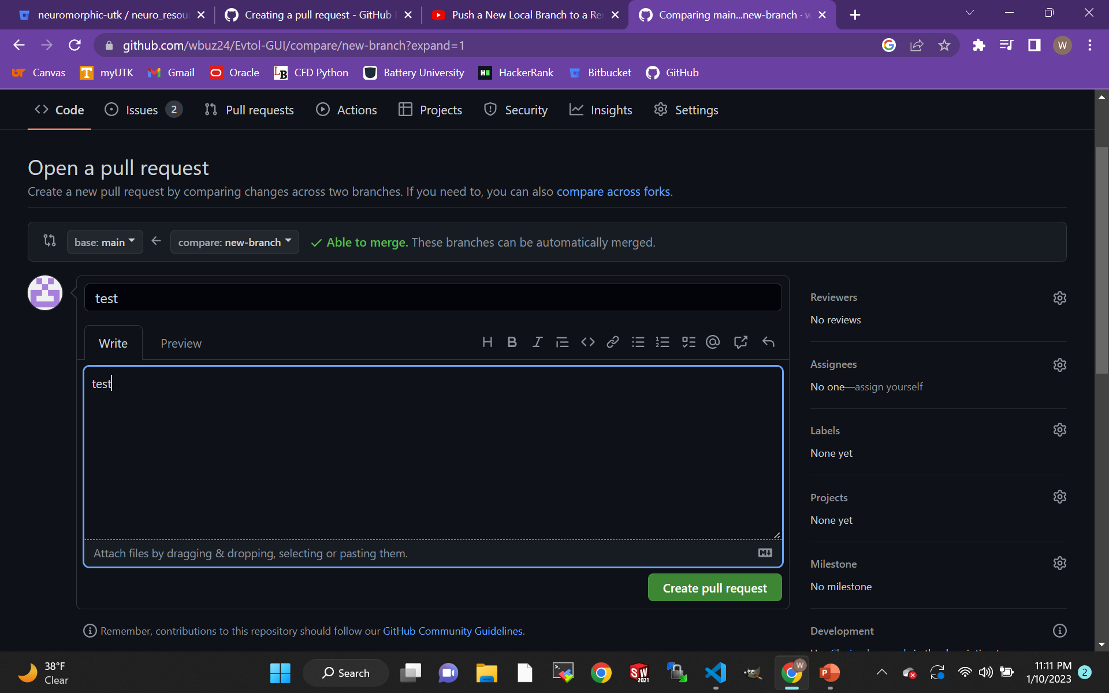
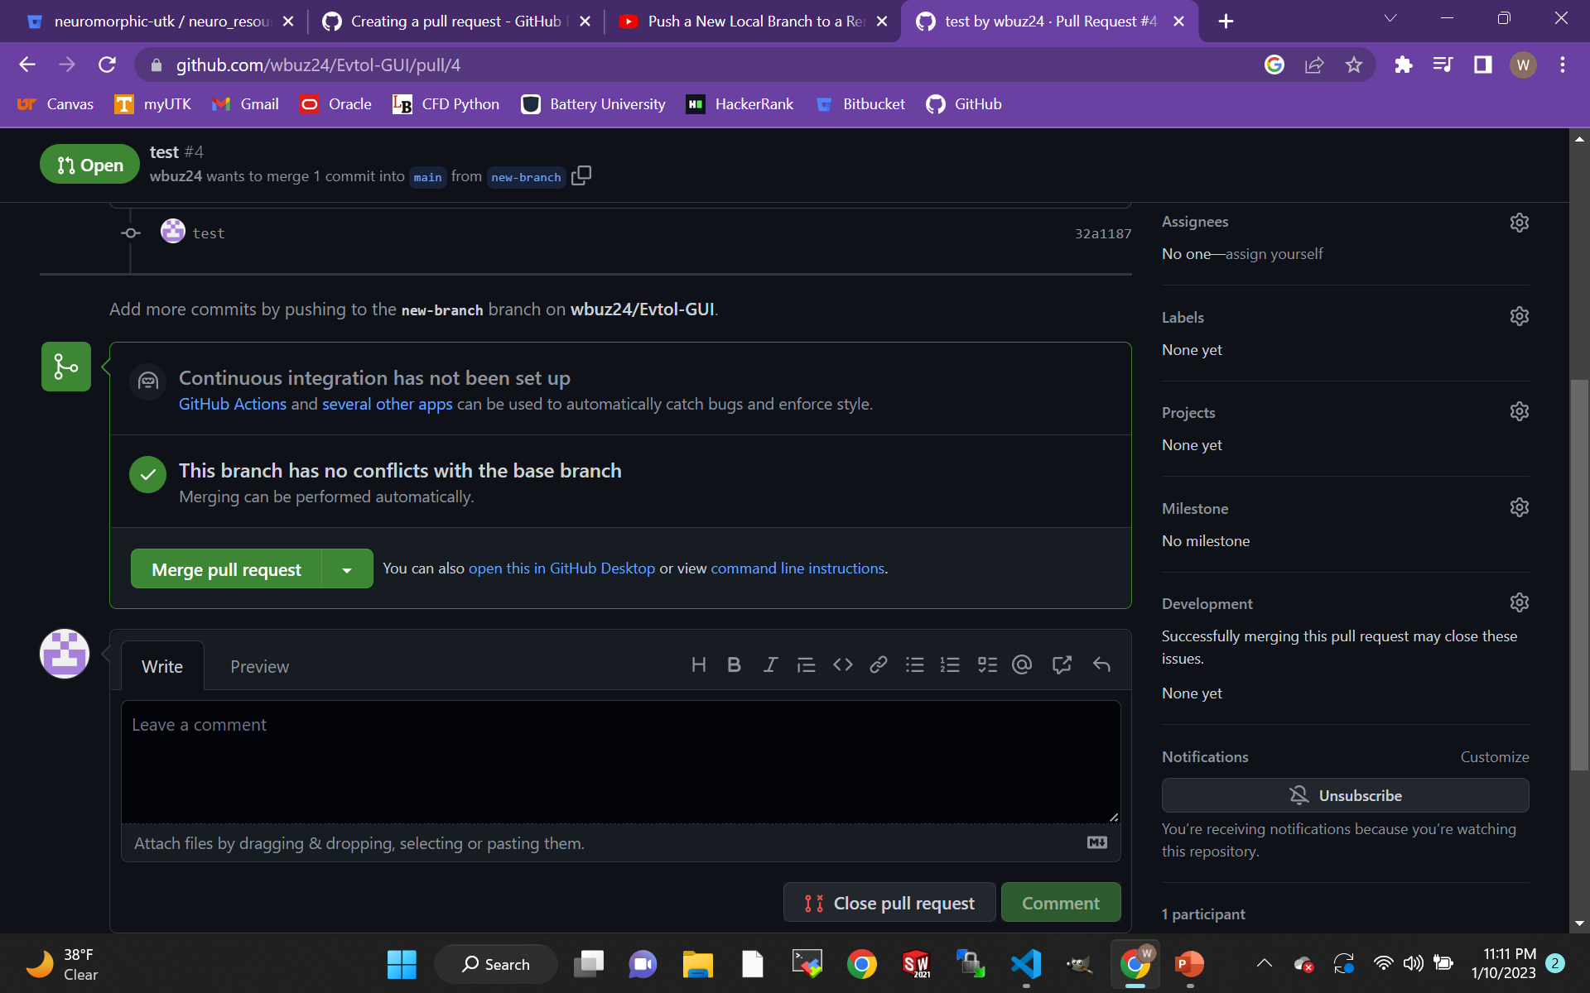
Pull Requests notify collaborators for review
After you have pushed your new branch to Github, you can initiate a pull request to review the code and merge with the main branch
Pull requests can be sent to individual collaborators
“Pull Requests” initiate review for merging with the main branch

Slide 14
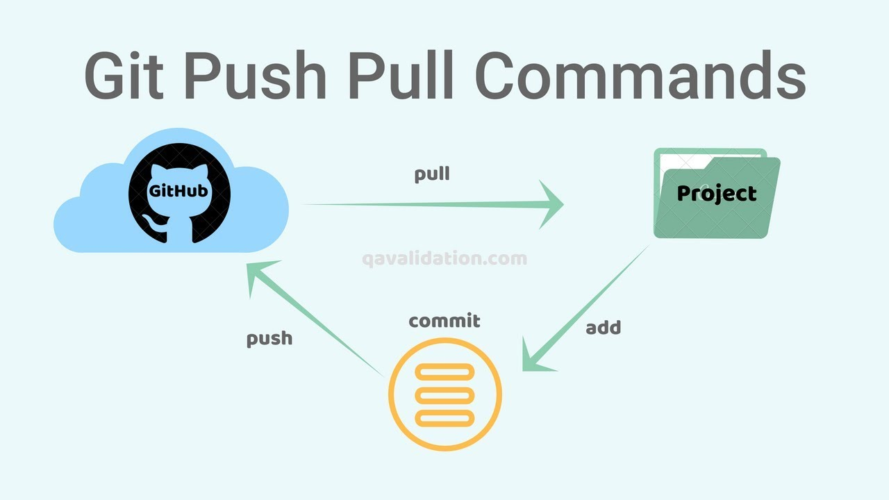
Proper Git usage prevents overwriting
Once your branch is merged to the main branch, it is safe to delete the branch that you had created.
If your local repo is not up to date, you may experience a “non-fast-forward” error (your branch is not up to date)

Slide 15
“git pull” prevents overwriting collaborators work
When a collaborator pushes a branch to Github and merges the changes with the main branch, use “git pull” to update your local copy of the main branch.
It is important that you pull new commits of the main branch before you push your branch to Github, so you merge your collaborators work
If a collaborator has pushed a branch to Github that has not yet been merged with the main branch, but you would like to pull that branch and experiment with your own new branch you will use “git fetch”

Slide 16
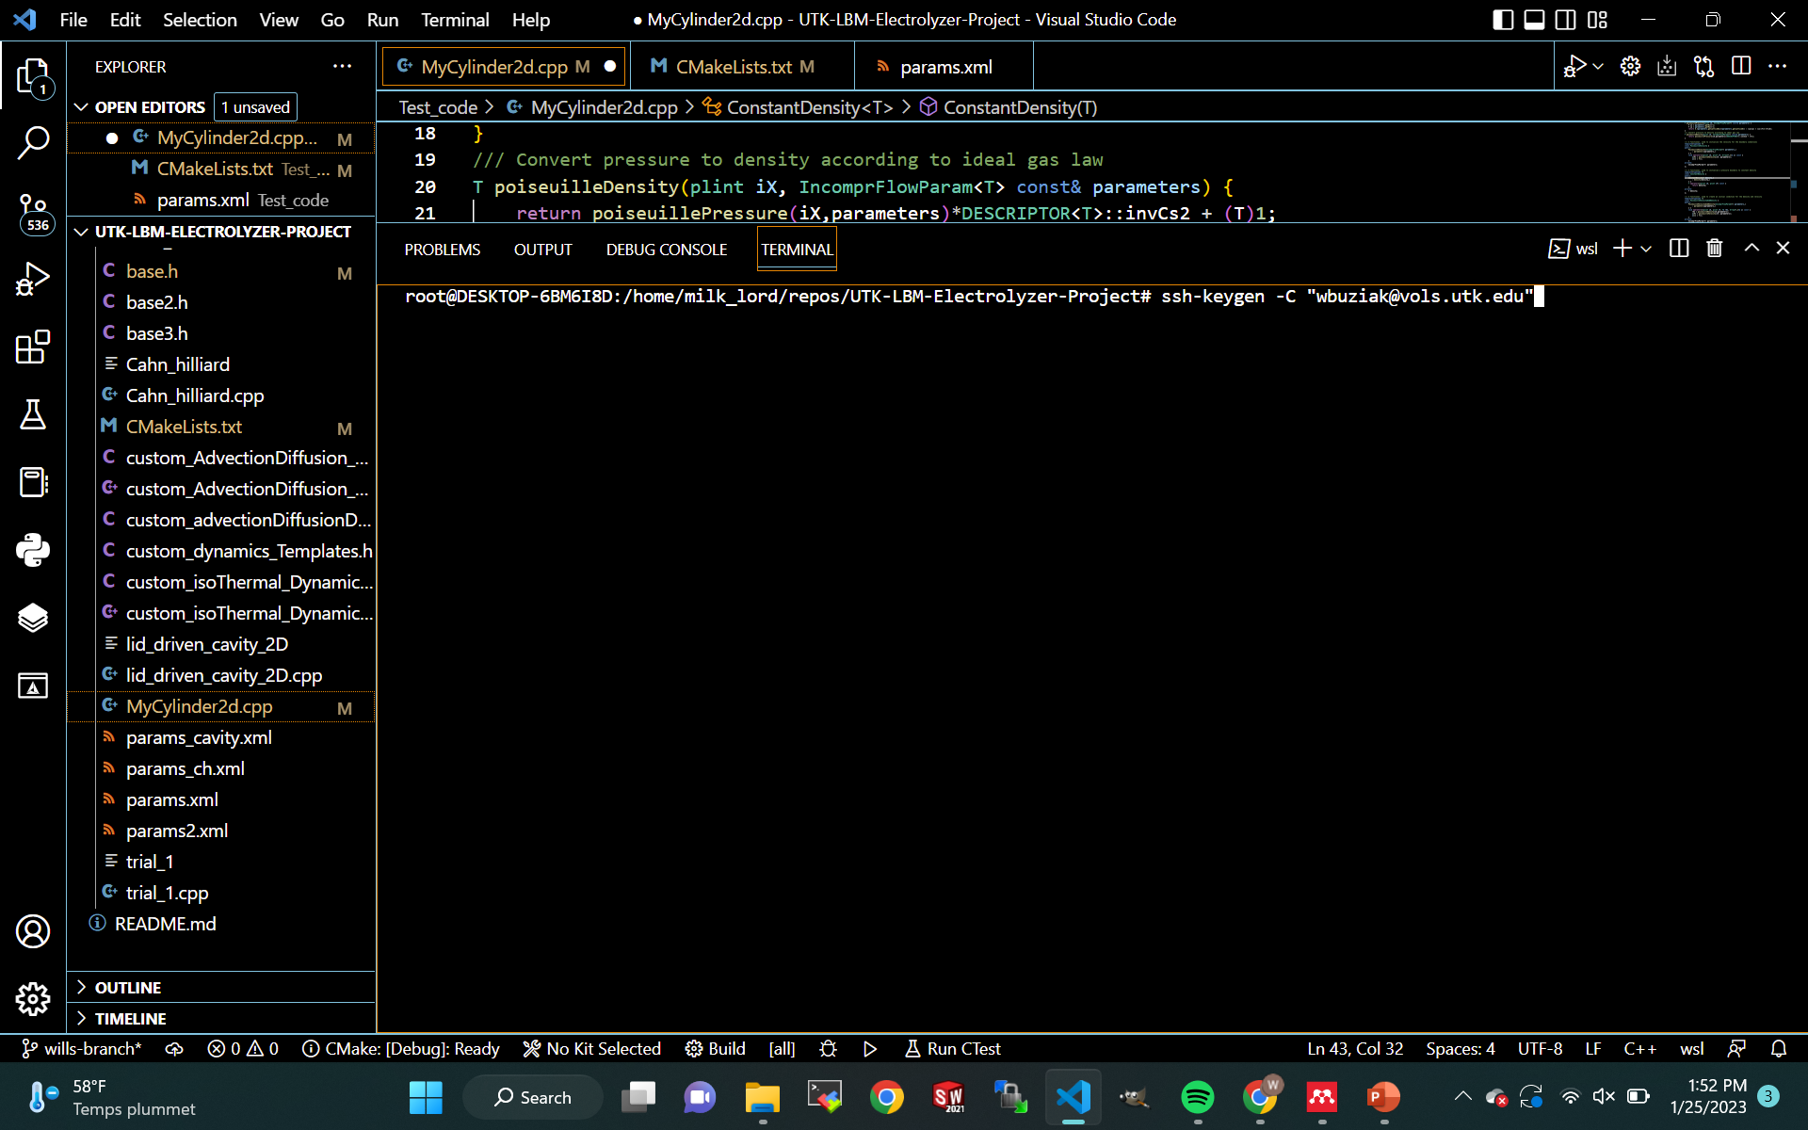
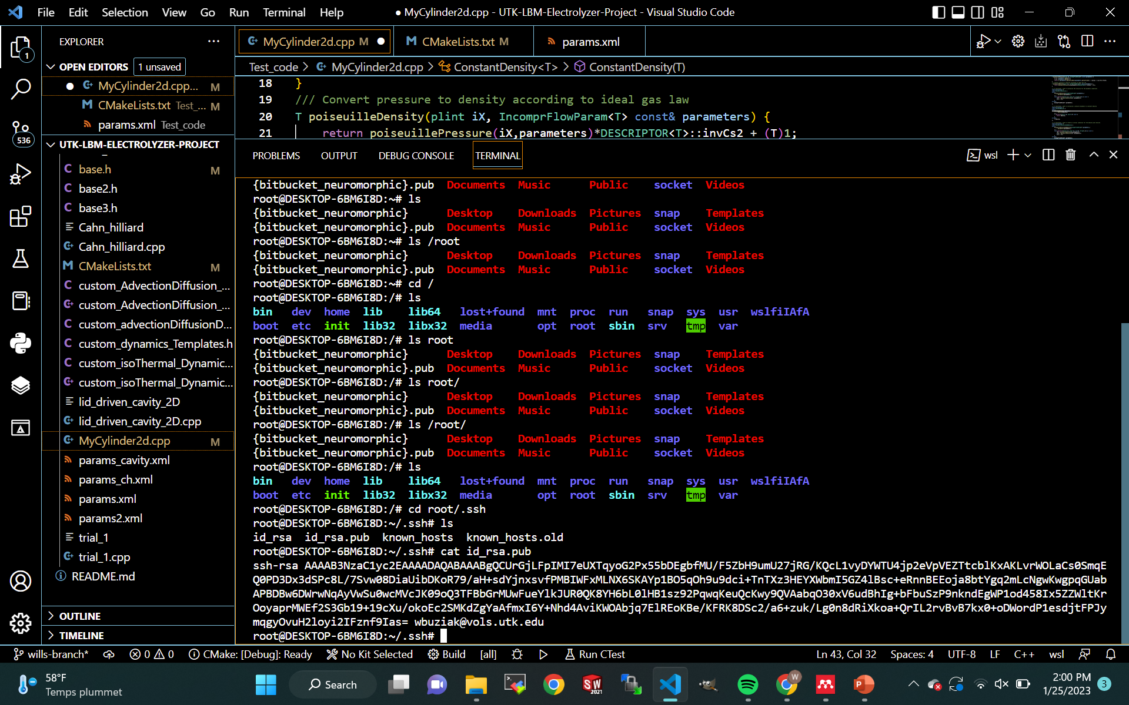
Connecting to Github through SSH
Connecting to Github with SSH prevents the need to input your password every time you would like to clone, push, or pull to a private remote.
Connecting with SSH is simple but can become difficult if you do not have a strong grasp of your machine’s directories.
Step 1: Open your terminal and navigate to your root directory (“cd”)
Step 2: Run the “ssh-keygen -C <user.email>” in the command line.
“-C” flag is a capital ‘C’ for ‘comment’
Use your primary email for Github (“Emails” tab under “Settings”)
Step 3: Locate your .ssh folder (Linux: /root/.ssh/ – Windows: C:/Users/<user>/.ssh/)
Step 4: Copy your key from the “.pub” file generated inside your “.ssh” folder.
“cat id_rsa.pub”

Slide 17
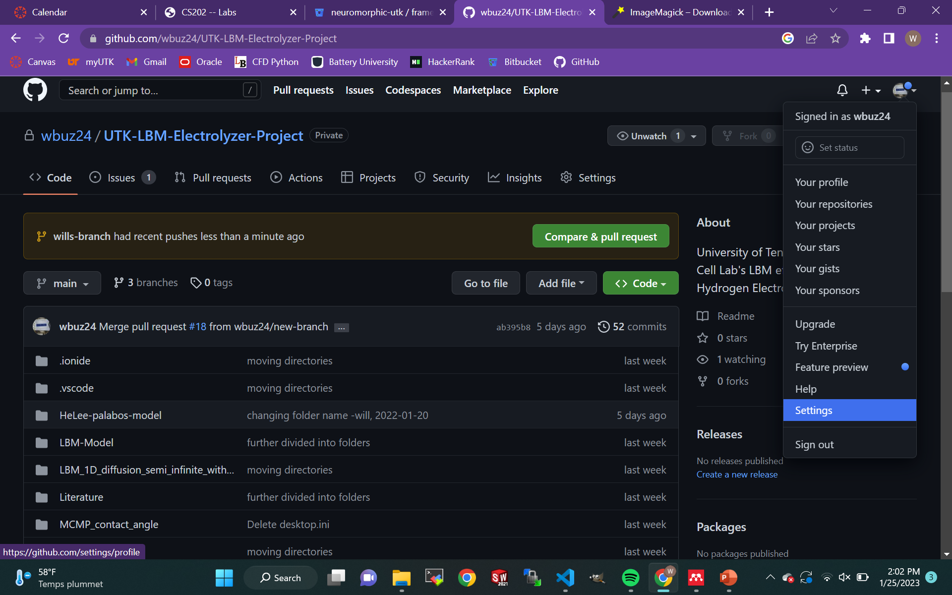
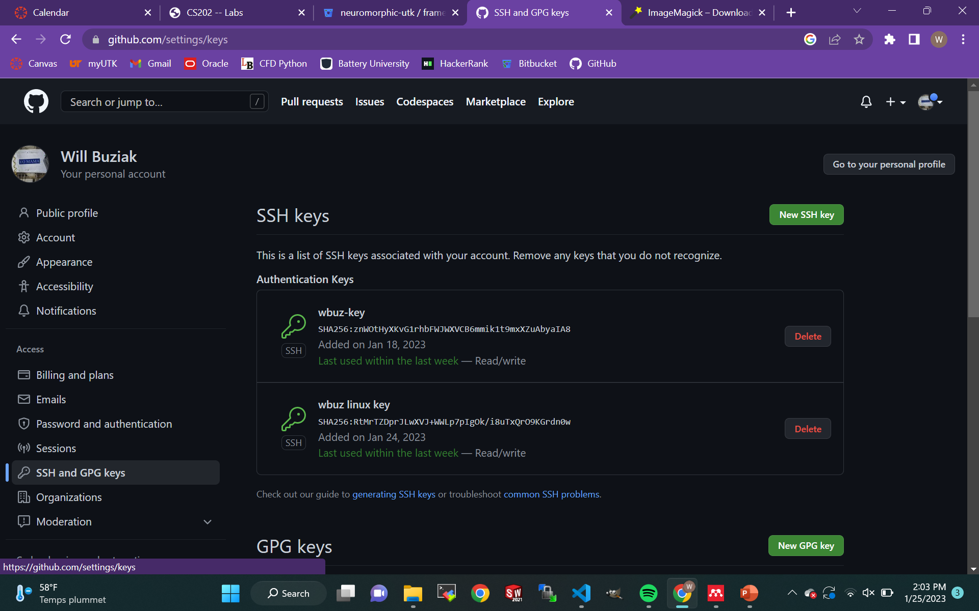
Copy and Paste your SSH Public key in Github
Step 5: Navigate to ‘Settings’ on Github
‘SSH and GPG keys’ tab
Step 6: ‘New SSH Key’
Create a new key, name it, and paste the key from your local machine
You should receive an email notifying you of a new key generation
Github now has a public/private key pair to authenticate your machine

Slide 18
Other Useful Commands - Naming and navigation
“git remote -v” will show all the remotes you have locally and their names
“git remote” can also be used with:
add <name> <URL>
rename <old> <new>
remove <name>
Among others
“git switch <branch>” switches to a branch
“-c” flag creates a new branch
“git rm” removes files from a working tree
“git restore” restores a working tree’s files
“git help” lists common commands
Note: Git only works when operating in a Git repository (directory)

Slide 19
References
Github Docs
https://docs.github.com/en
https://git-scm.com/book/en/v2/Getting-Started-First-Time-Git-Setup
Tennlab Neuromorphic Research Git presentation
https://bitbucket.org/neuromorphic-utk/neuro_resources/src/master/presentations/git_presentation/images/
“Push a New Local Branch to a Remote GitHub repo with Git”
https://www.youtube.com/watch?v=se1WitSPKwc
“Difference between git PULL and git FETCH”
https://www.youtube.com/watch?v=Mdo7hvlUJ-U
Connecting to Github with ssh
https://docs.github.com/en/authentication/connecting-to-github-with-ssh

